Slide 1
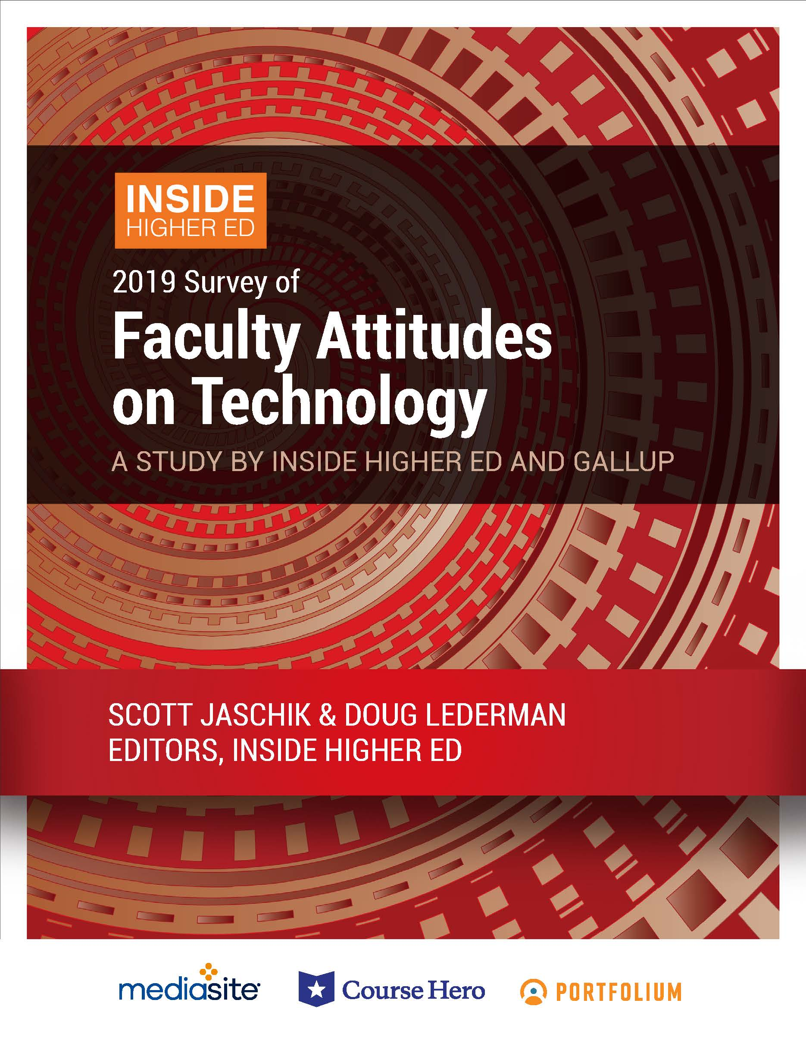
Faculty Attitudes on Technology: a Survey
An Inside Higher Ed webcast
Thursday, Dec. 5, 2019
2 p.m. Eastern
Notes:
Good afternoon.
My name is Doug Lederman, editor and co-founder of Inside Higher Ed.
Thanks for joining us today for this webcast on IHE’s 2019 survey of college and university business officers.
Really pleased you’re taking time out of your busy days to participate in this discussion.
(Shift slides)
Joined today …

Slide 2
Presenters
Doug Lederman, editor, Inside Higher Ed, doug.lederman@insidehighered.com
Scott Jaschik, editor, Inside Higher Ed, scott.jaschik@insidehighered.com
Notes:
Joined today by my co-editor and co-founder, Scott Jaschik.
In the first half hour or so, Scott and I are going to run through the results of the survey, and then we’ll try to address your questions.
You don’t have to wait until then, though, and we encourage you to start submitting your questions as soon as they occur to you. You can do that in the Q&A field next to the presentation box on your screen.
Wanted to offer a couple of thanks.
First to our colleagues at Gallup, our survey partner, who did the survey work and much of the data analysis for us.
Second, thanks to the advertisers whose financial support helped make survey possible:
EY Parthenon Jenzabar Laserfiche Oracle Touchnet

Slide 3
Methodology
Questions prepared by Inside Higher Ed, in collaboration with Gallup.
Polling conducted by Gallup in August/September.
Responses from 1,967 faculty members and 178 “digital learning leaders;” nationally representative.
Complete anonymity for respondents, but answers coded to allow for breakdown by rank, sector, etc.
Notes:
Bit of background on surveys: CBO survey is part of series that Inside Higher Ed started in 2011 to take the temperature of key campus decision makers on pressing and timely issues confronting their institutions.
Our goal – help campus leaders understand, at a national level, what their peers are thinking and doing about the common issues and challenges they’re wrestling with.
Have also surveyed presidents, cc presidents, provosts, admissions directors, and we do an annual survey of faculty views on technology.
In each year’s survey, we ask some questions that stay the same from year to year, to try to build some longitudinal data that allow for temperature taking of the state of the enterprise, and some new questions designed to zero in on the issues of the moment.
See questions this year about
Quick look at methodology …

Slide 4
A Slow, Steady Uptick
Notes:
Notes:
As seen in the chart below, which begins with Gallup's first iteration of the survey in 2013, that percentage has grown from three in 10 and seems on an inexorable march toward half and beyond.

Slide 5
Differences by Demographic
Notes:
While faculty participation in online learning continues to edge up over all, it is extremely uneven -- by institution type, discipline and mind-set. As seen in the table below, public college instructors are far likelier than their private college peers to have taught an online course; midcareer professors are more likely to teach online than are their younger or older peers; and social science and professional school faculty members are likelier to teach online than their science and humanities counterparts.

Slide 6
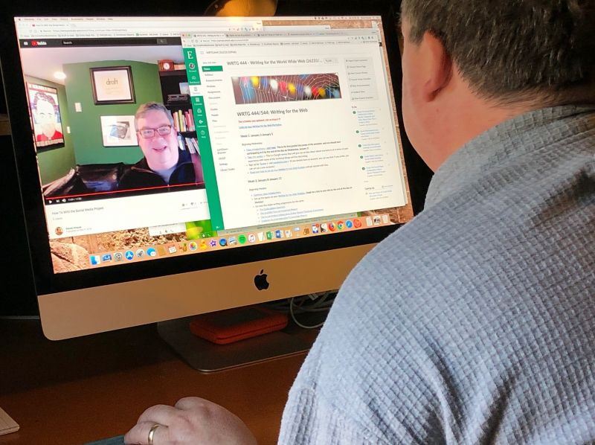
Professors Say Teaching Online Makes Them Better
Three-quarters (77%) of instructors who have taught online say they have developed pedagogical skills and practices that have improved their teaching.
75% think more critically about engaging students with content; 65% make better use of multimedia content; 63% more likely to experiment and make changes to try to improve the learning experience.
Two-thirds of instructors who had converted face-to-face course to an online or hybrid (blended) class said that they spent less time lecturing (65%) and incorporated more active learning techniques into the new course (69%).

Slide 7
Persistent Doubts
Notes:
Stubborn
As seen in the chart below, slightly more faculty respondents disagree (36 percent) than agree (32 percent) that "online courses can achieve student learning outcomes at least equivalent to in-person courses at any institution" -- presumably representing their overall view of online education. (The other 32 percent of respondents chose a middle ground.) Those figures have remained largely steady in the last three years of the Inside Higher Ed survey.
But feel better about online closer to what they know …
The ratios change significantly by subgroup of faculty members. Community college instructors, for instance, are more likely to agree than disagree that online learning can achieve equivalent outcomes in the classes they teach by a 53 to 31 percent margin, while the ratio for private college baccalaureate professors is 15 percent agree to 72 percent disagree.
Forty-six percent of female professors agree and 36 percent disagree with that statement, while the ratio for men is 31 percent agree vs. 49 percent disagree.

Slide 8
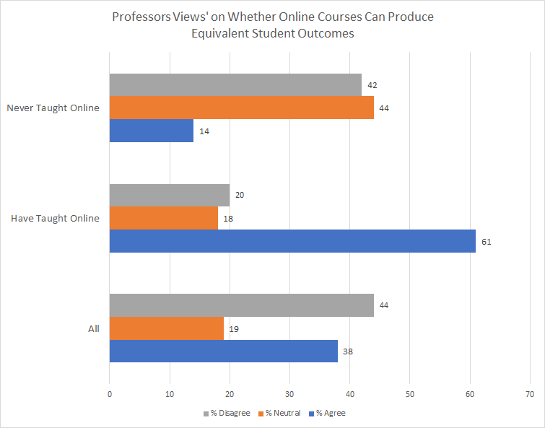
Support Builds As Professors Teach Online
Notes:
And the biggest divide of all, not surprisingly, comes among those who have taught online vs. not, as seen in the chart below: 61 percent of those who have taught online agree that outcomes can be at least equivalent, compared to 14 percent of those who have not taught online.

Slide 9
How They View Technology - I
About a third (35%) of faculty respondents characterized themselves as early adopters, with a majority (54%) describing themselves as “followers.” One in 10 described themselves as opposed to technology.
39% of professors said they “fully support” increased use of educational technology, up from 32% last year and 29% in 2017. 41% of instructors said they "somewhat" support technology in the classroom; the rest were either neutral or opposed.
--iStock

Slide 10
How They View Technology - II
Professors who support educational technologies say they do so because "some students simply cannot attend a face-to-face class due to work or family obligations“ (64%) and "students learn better when I engage them with effective technology tools“ (57%).
Instructors who oppose academic technology do so because "instruction delivered without using technology most effectively serves my students“ (65%), "there is too much corporate influence" (47%) and "faculty lose too much control over the course when they use technology" (35%).

Slide 11
Sufficient Support?
Asked to rate institutions’ support for using technology, professors:
Rated colleges positively on encouraging experimentation with new approaches to teaching (56% agree) and providing adequate technical support for creating and teaching online courses (52% agree for both).
Found their institutions inadequate in most other categories: "acknowledges time demands for online courses for workload" (25%), appropriately rewards contributions to digital pedagogy (22%), rewards teaching with technology in tenure and promotion decisions (22%), and compensates fairly for development of an online course (22%) all received consent from under a quarter of instructors. --istock.com/

Slide 12
‘Swim as Fast as They Can’
"There seem to be a lot of institutions where faculty are told to teach online, and there's not as much of an intersection with support. When that's the case, the professors probably feel like they can't really transfer what they do into online -- all they can do is swim as fast as they can. We have to do better than that if we want faculty to believe they can be effective.
--Vincent Del Casino Jr., provost, San Jose State U.

Slide 13
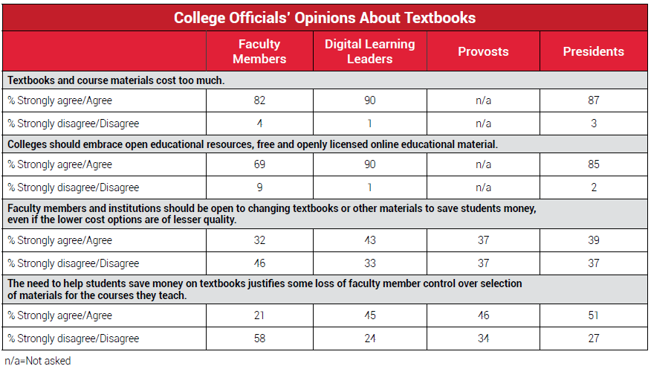
Textbook Prices

Slide 14
Assessment of Assessment
 | % Agreeing, 2018 | % Agreeing, 2019
Assessment primarily about satisfying accreditors and politicians | 59% | 49%
Assessment efforts “have improved quality of teaching and learning” | 25% | 33%
Notes:
Many professors don’t like assessment: 49% say their college's use of it is "more about keeping accreditors and politicians happy than it is about teaching and learning."
And only a third agree that "assessment efforts have improved the quality of teaching and learning at my institution.
But in 2018, 59% agreed with that "assessment efforts seem primarily focused on satisfying outside groups such as accreditors or politicians."
And 25% agreed that assessment has improved the quality of teaching and learning at their institutions.

Slide 15
Cost and Price
Professors are evenly divided on whether it is less expensive to offer an online course; 55% of digital learning leaders disagree.
Both groups disagree more than agree that online courses should be priced lower than in-person courses, and agree more than disagree that "online courses cost less than in-person courses only if institutions reduce their spending on faculty, student support or other important factors."

Slide 16
Other Findings
Majorities of faculty members and of digital learning leaders oppose use of external companies to offer most functions in online delivery: instructional design, offering student support, developing educational content or training the faculty. Exception: marketing.
More than 2/3 of instructors say institution offers training on how to make course materials compliant with the Americans With Disabilities Act.
Three in five professors say academic fraud occurs more often in online courses than in face-to-face courses. Digital learning leaders overwhelmingly (86%) say fraud happens in both settings equally.
Notes:
The only area in which a majority of online education administrators (61 percent) and a near majority of faculty members (44 percent) favor the use of outside companies is in marketing to prospective students.

Slide 17
With Thanks

