Slide 1

PROTECTING
Vulnerable Students
During the Pandemic
An Inside Higher Ed webcast
Tuesday, June 30, 2020
2 p.m. Eastern

Slide 2
Presenters
Paul Fain, news editor paul.fain@insidehighered.com
Madeline St. Amour, reporter madeline.stamour@insidehighered.com
Kristin D. Hultquist, founding partner,
HCM Strategists

Slide 3
Introduction
The pandemic’s disproportionate impact on vulnerable students was immediately apparent:
“The whole U.S. political economy was like a giant pre-existing condition. And COVID came along and exposed it all.”
-- Richard V. Reeves, Brookings

Slide 4
Economic pain, equity gaps & uncertainty
Survey: 23 percent of Black Americans and 24 percent of Latinos have been laid off, compared to 15 percent of white Americans
FAFSA renewals down 8 percent for students with family incomes of less than $25K, but just 1 percent with incomes of more than $50K
Survey: 84 percent of Black undergrads are concerned about being on track to graduate, 81 percent of Latinos and 77 percent overall

Slide 5
John B. King Jr., president, CEO of The Education Trust:
“The toll of this pandemic is, in a word, devastating. It’s eroding students’ academic success, their emotional well-being and their personal finances.”

Slide 6
An Unprecedented Spring
The great online pivot, its ripple effects and unintended consequences:
Pass/Fail and grading in a pandemic
Lower-income students unable to leave campus amid closures
Mutual aid networks
Emergency aid
Parking lot WiFi

Slide 7
Noah French, sophomore at the University of Texas at Austin
“Right now students don't know what the future holds. They don't know how they're going to be able to pay their rent, pay their utilities.

Slide 8
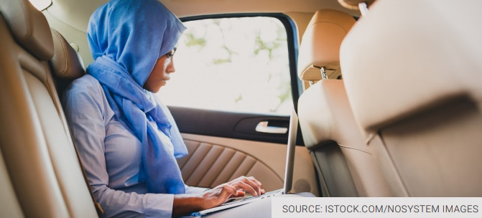
Reserved: Internet Parking

Slide 9

How Neurodivergent Students Are Getting Through the Pandemic
Students with anxiety disorders, autism and other disabilities struggle with disruption of their normal routines after the move to remote education.

Slide 10

Coronavirus Roundup
Everything you need to know about higher ed and the coronavirus in one easy-to-read package (with some distractions to help your sanity).
Image Source: ISTOCKPHOTO.COM/PIXELCI

Slide 11
Perception Gaps
86 percent of white people and 89 percent of Asian Americans believe those who pursue higher education will have more job opportunities than those who do not.
But only 69 percent of Black people and 74 percent of Latinos agreed.
-- Survey results from New America

Slide 12
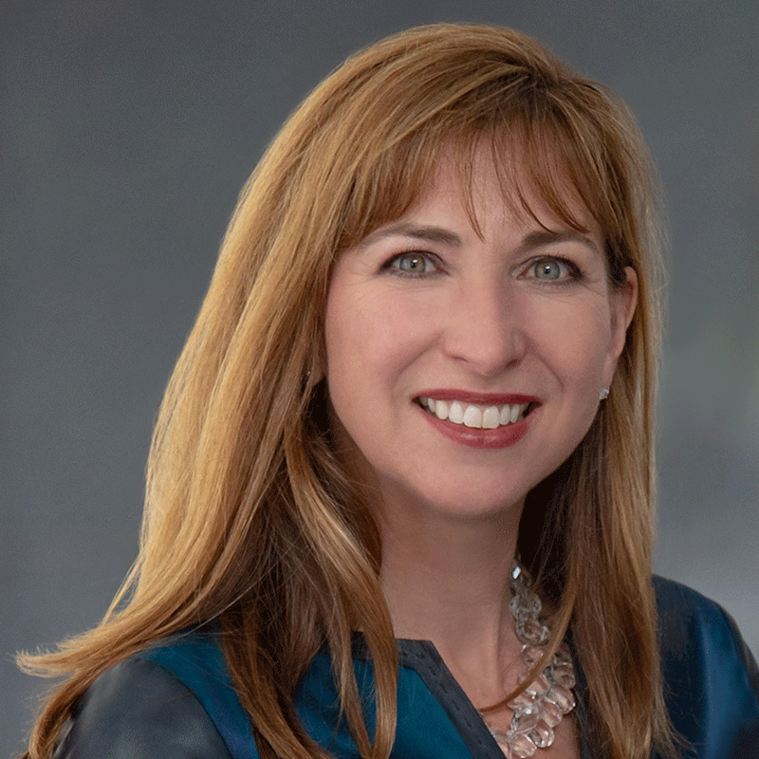
Welcome
Kristin Hultquist (formerly Conklin) is a nationally-renowned expert in higher education policy and strategy development at the state and federal levels. In 2008, Kristin joined Terrell Halaska and Michael Manganiello as a founding partner of HCM Strategists, a public policy and advocacy consulting firm committed to reducing disparities in health and education.

Slide 13

Racial Justice and Equity Resolution, MSU Denver Board of Trustees: www.msudenver.edu/trustees/resolution-racial-justice-and-equity/

Slide 14
Policy Brief
A Generational Challenge: State Postsecondary Education Policies to Support Economic Recovery and Individual Opportunity
-- Joni E. Finney, Kristin D. Hultquist, Scott D. Pattison, Martha J. Snyder
https://www.gse.upenn.edu/news/covid-19-higher-education-budgets

Slide 15
Q&A

Slide 16
Thanks for Tuning In!

Slide 17

With Thanks....

Slide 18
How Can We Do Better?
Email comments, questions and concerns to paul.fain@insidehighered.com

